Slide 1
CMPE279 Project Presentation
IoT Trash Can Monitoring System
Gaochao Wang
Ruizhe Song
Zixin Li

Slide 2
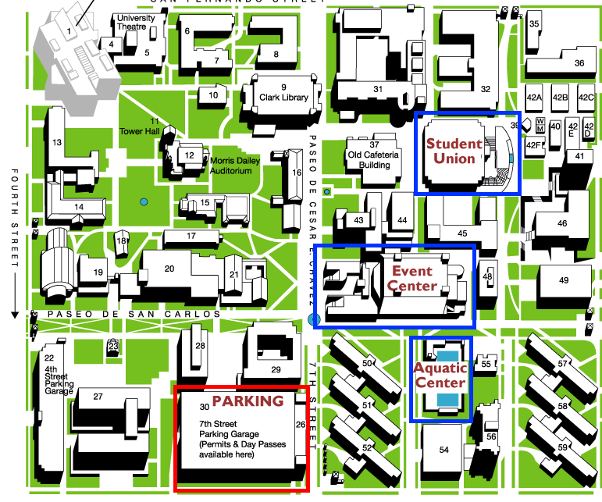
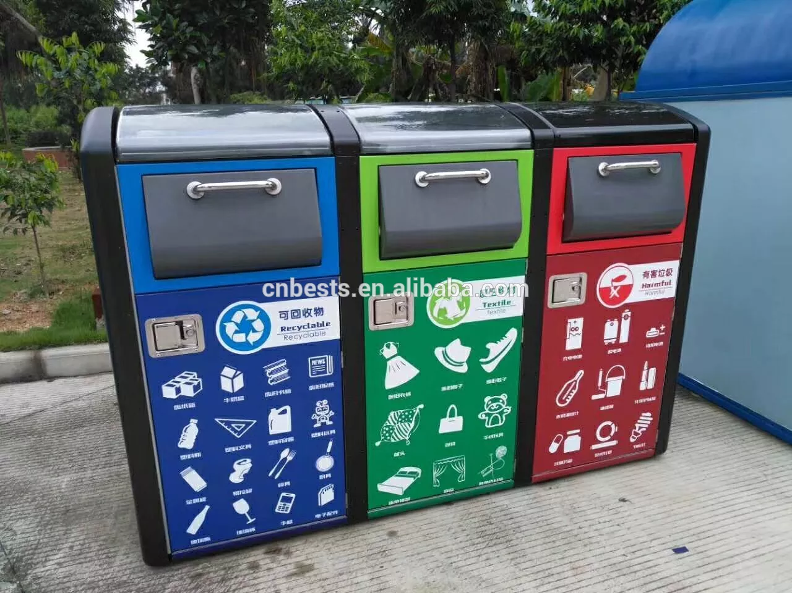
Introduction
It is a challlenging task to find out how many spots, how large the trash can is needed, and how often trash needs to be collected, to keep a clean environment in a cost effective way. Our Iot project is to provide a real time trash data monitoring and notification system for a environment like campus, park, shopping mall, etc.

Slide 3
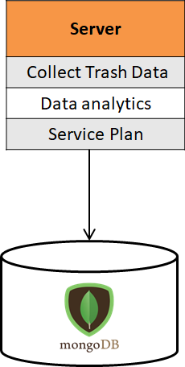
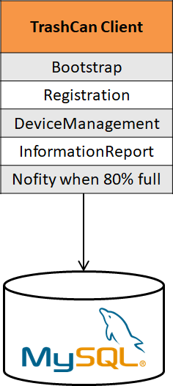
Architecture
Front End UI
Front End UI
Server
Read
Read
Response
Read
Response
Response
Client
Client
Client

Slide 4
TrashCan
send_data_to_frontEnd
get_query_result
Init device on connection
Return_reading_to_server
Auto_report_data
Front End
Server
TrashCan
Assign Device ID
Get_cur_reading
Init Viewer on Connection
Get_cur_reading_from_server
query_data_on_server
TrashCan
Front End

Slide 5
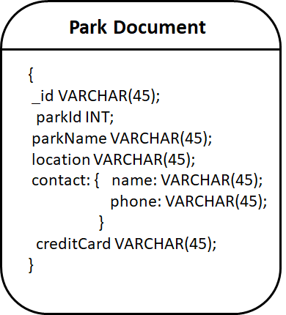
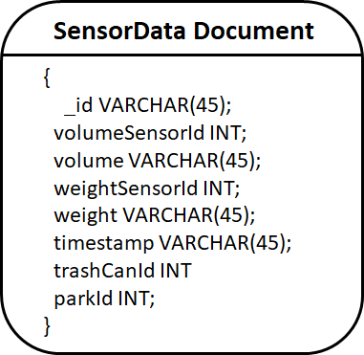
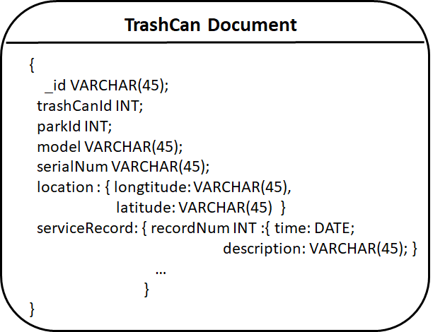
Database Schema
Server Side: MongoDB

Slide 6
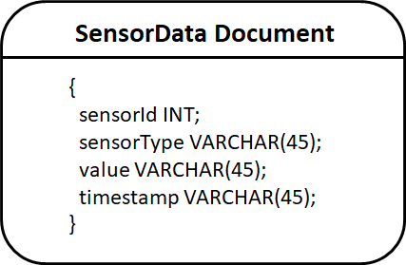
Database Schema
Client Side: MySQL
3 sensor: GPS, Volume, Weight

Slide 7
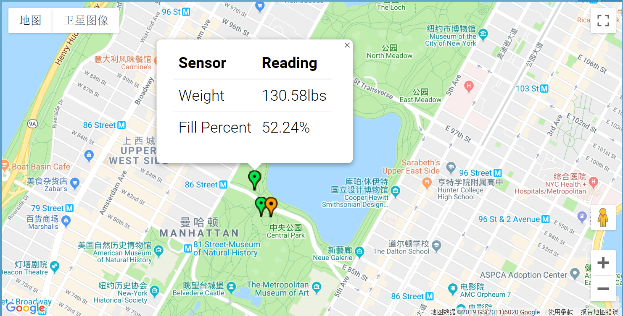
Garbage Can Trash Initiation
Factory Bootstrap
Register to Server
Report Location

Slide 8
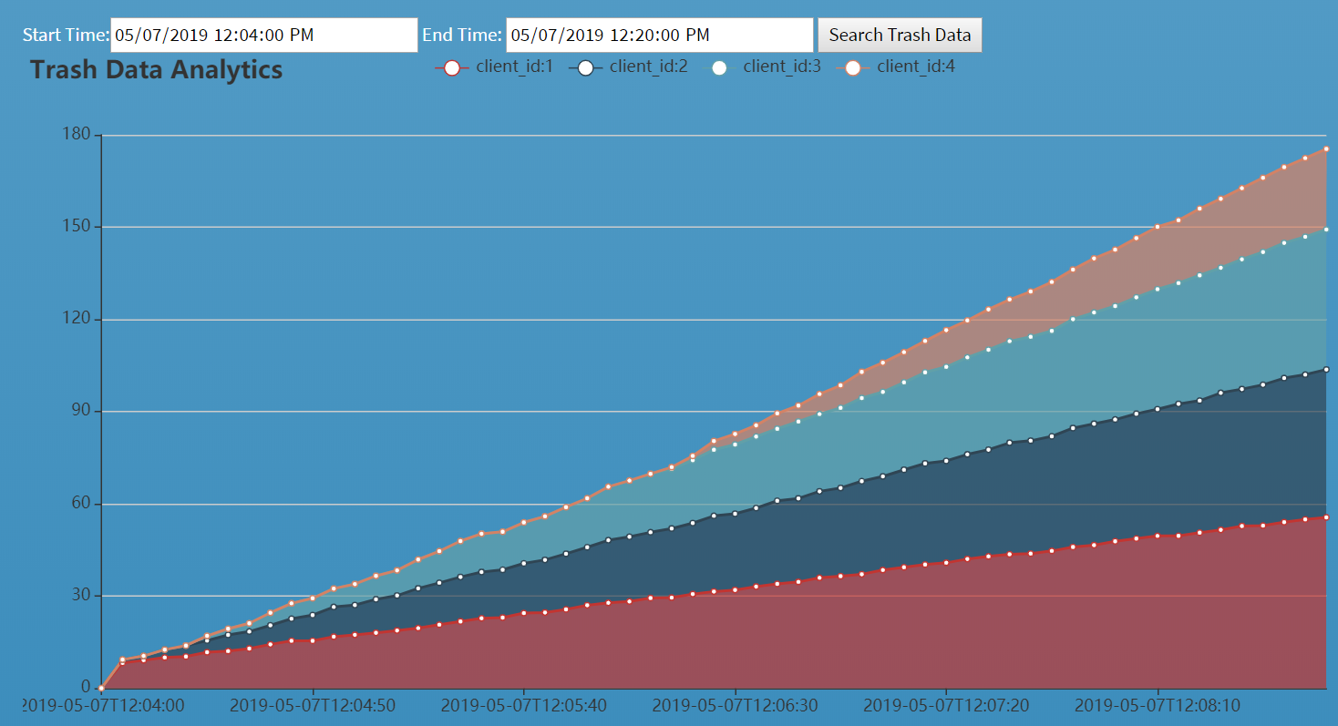
Trash Data Analytic for Permium Plan

Slide 9
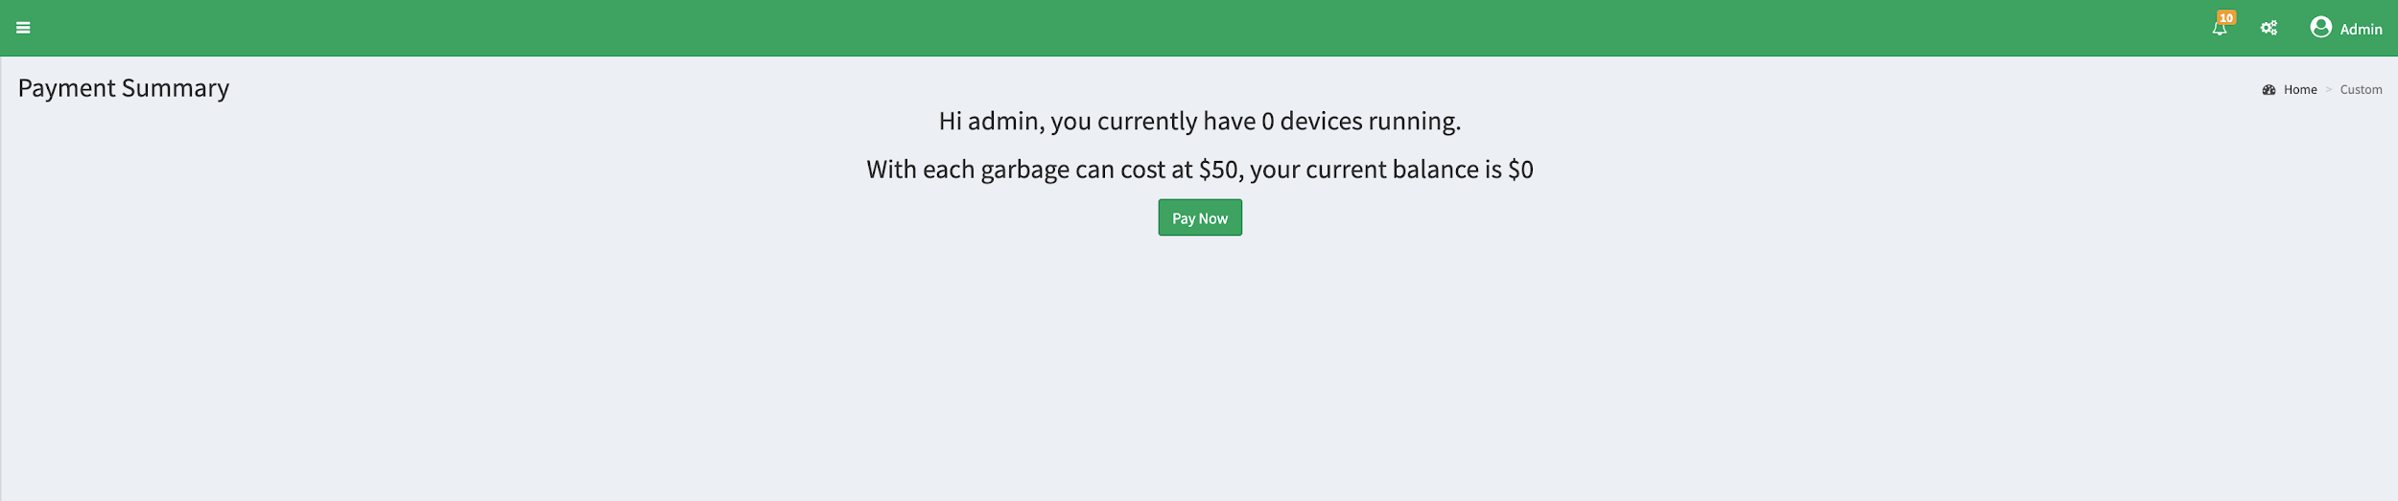
Service Payment Tab
Email bill to custermer

Slide 10
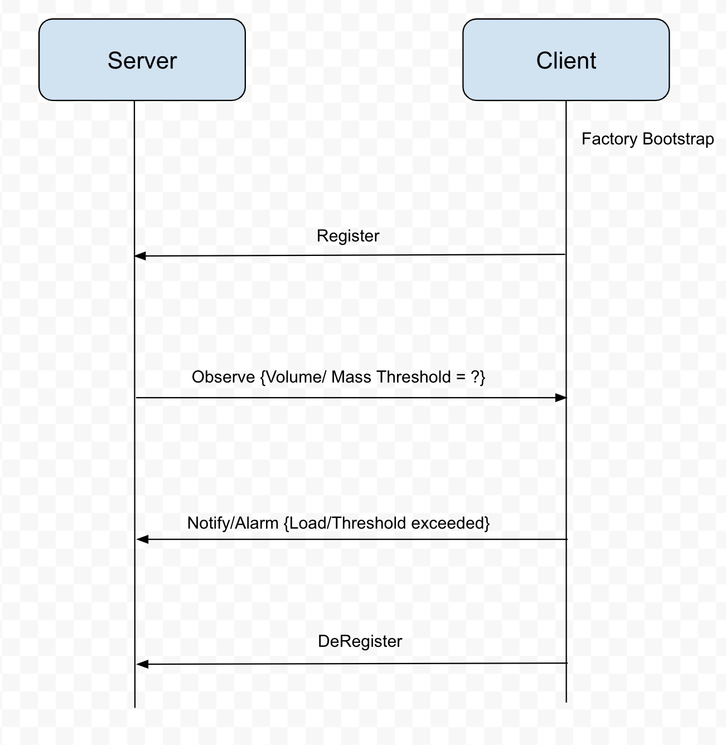
Use Case #1
Trash cans report to server when it reaches 80% full.
Server uses Information Report Interface to send observe operation to set a threshold(80% volume) on client side, and let trash can to notify server when it reach the threshold. A notification email will be also to sent out to remind customer
Resources used:
server side: volume/weight ;
client side: volume/weight

Slide 11
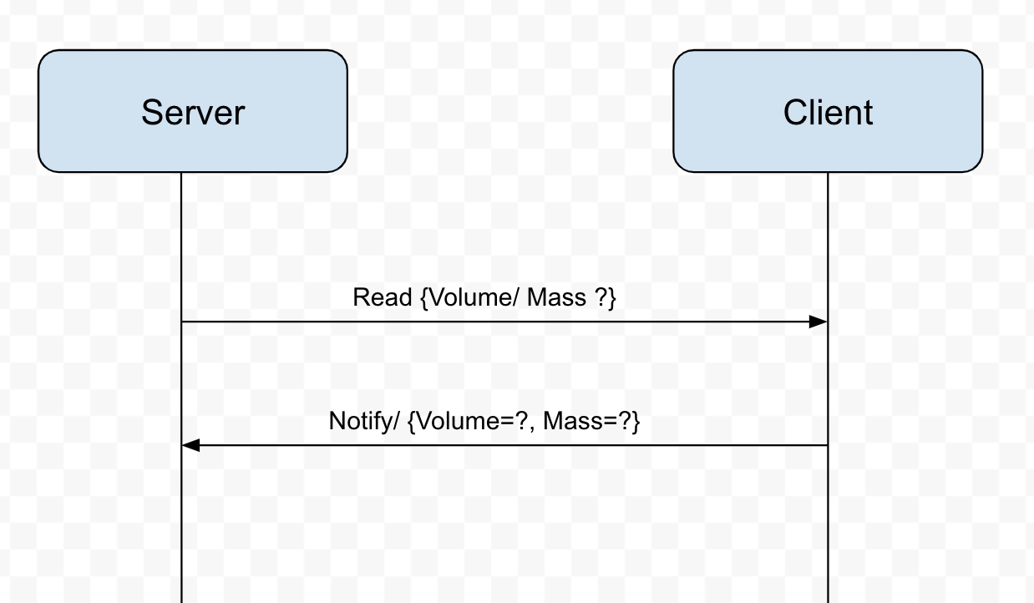
Use Case #2
Server collects all client trash data every 5s.
Server uses Device Management Interface to send read operation to get data(volume/weight) on each client, and calculate the total trash volume and weight for the park.
Resources used:
server side: volume/weight ;
client side: volume/weight

Slide 12
Future Improvements
Bio-Hazard Detection and Control
Odor Sensor and Control
Fire Detection and Extinguishing

Slide 13
DEMO

